Slide 1

Class 10 Energy Flow, Forests, and Ecosystem Dynamics
Larry Swatuk
lswatuk@mta.ca

Slide 2
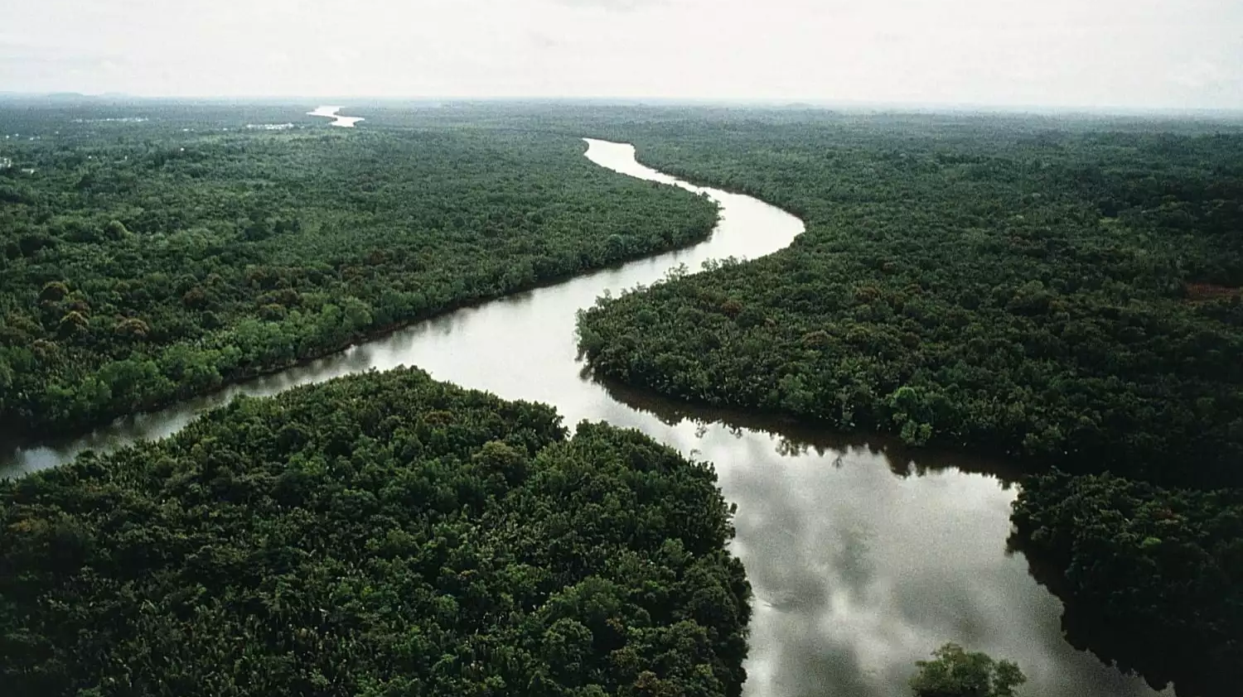
Forest Ecosystem
captures solar energy
builds complex structure (trees, soils, food webs)
releases:
heat
decomposed matter
O₂ and CO₂ (net CO₂ sink) and nutrients
The forest looks orderly, but it’s actually a machine for accelerating energy dissipation.

Slide 3
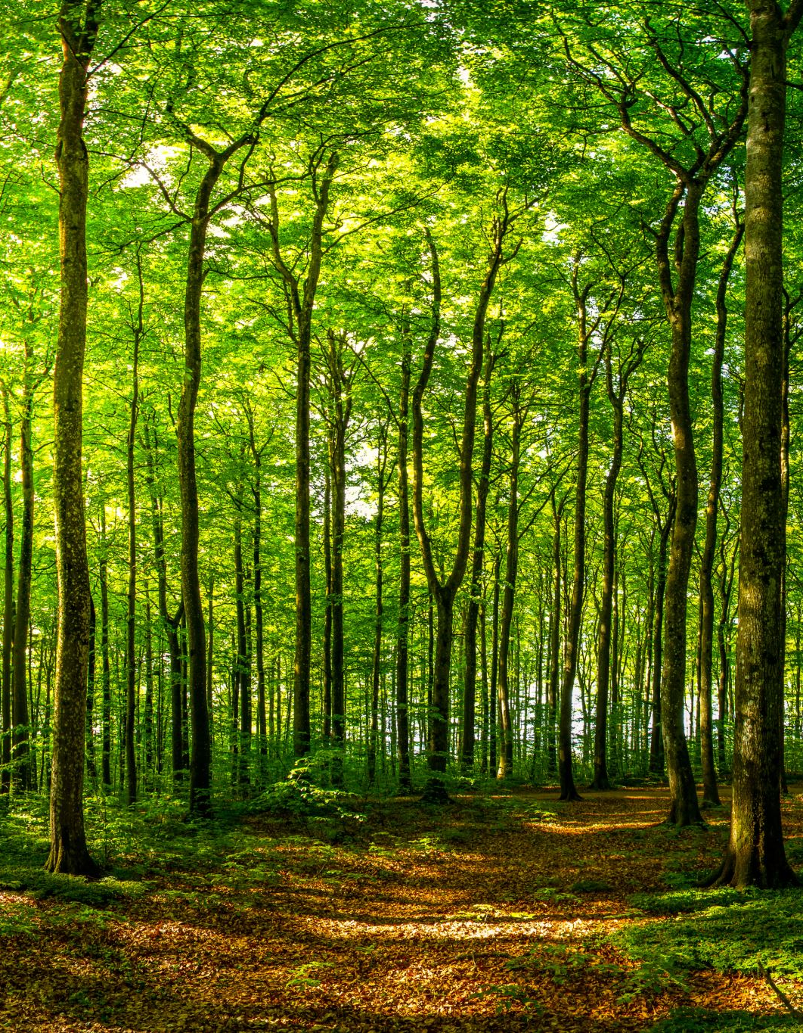
From Sustainable Forest Management ….
Socio-ecological system: Indigenous people managed forests as slow, complex energy systems
Forests captured solar energy over long time scales
Energy stored in biomass, soils, biodiversity
Human livelihoods embedded in these flows
Hunting, shifting cultivation, agroforestry
Materials, medicines, spiritual value
Waste and entropy absorbed locally:
Nutrients recycled
Forest structure regenerated

Slide 4

Ecosystem People
These systems maintained internal social and ecological order by letting energy move slowly, cyclically, and locally.
Low throughput
Low entropy export
High resilience

Slide 5
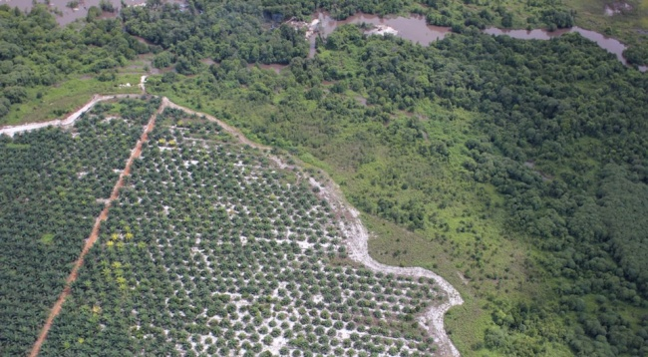
…to Unsustainable Forest (Mis)Management

Slide 6
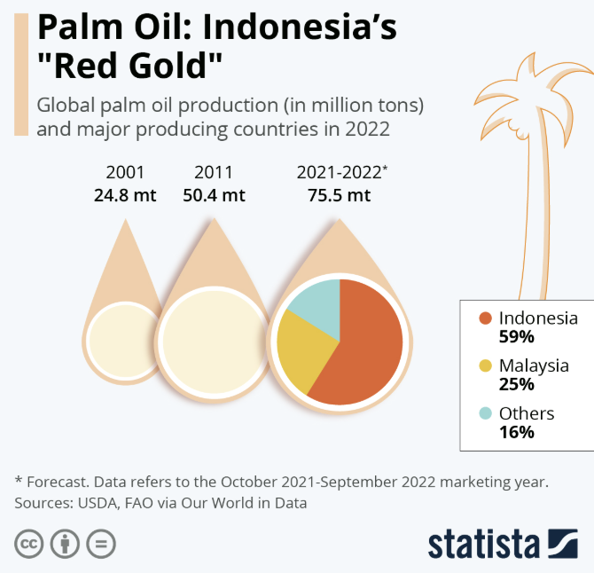
“Extroversion”: From Ecosystem People to Biosphere People
Major Companies Involved in Palm Oil Market:
FGV Holdings Berhad,
IOI Group,
Sime Darby Berhad,
Musim Mas,
Astra Agro Lestari,
Bumitama Agri,
Genting Group,
Kuala Lumpur Kepong Berhad (KLK),
Wilmar International,
Royal Golden Eagle,
Indofood Agri Resources,
Golden Agri-Resources,
First Resources,
Sampoerna Agro

Slide 7
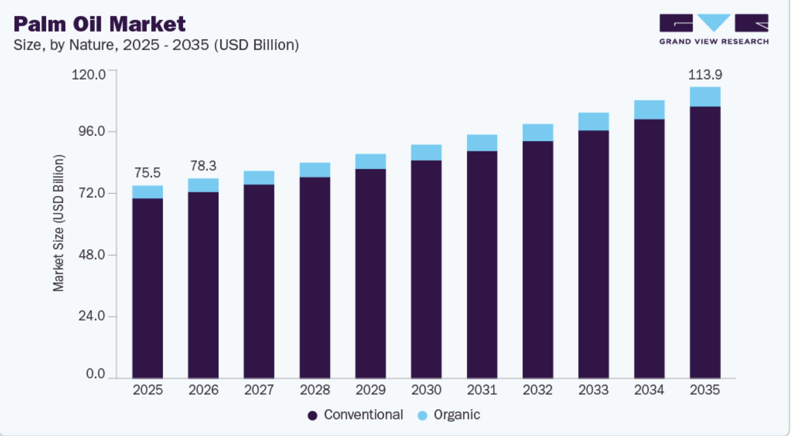

Slide 8
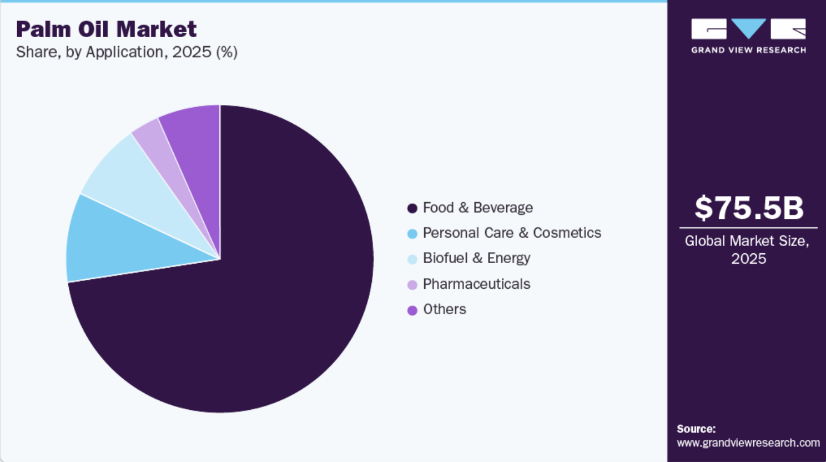

Slide 9
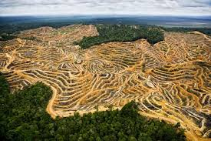
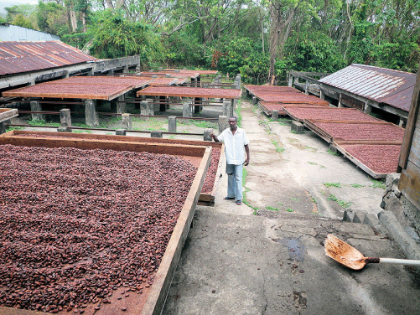
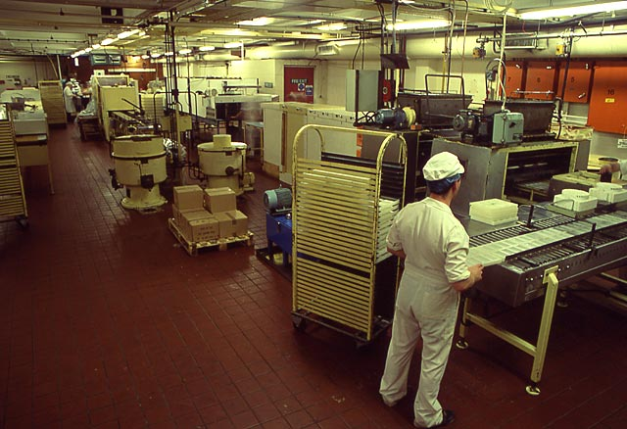
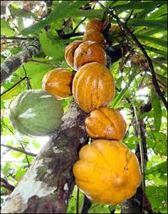


Land Conversion and Global Commodity Chains
processing
assembly
Raw materials
assembly
Final product

Slide 11
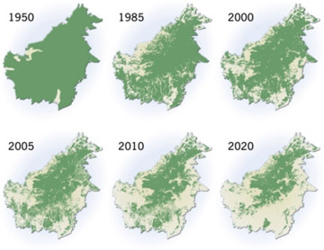
Deforestation in Borneo
Notes:
http://news.mongabay.com/2011/07/wwf-partnering-with-companies-that-destroy-rainforests-threaten-endangered-species/

Slide 12
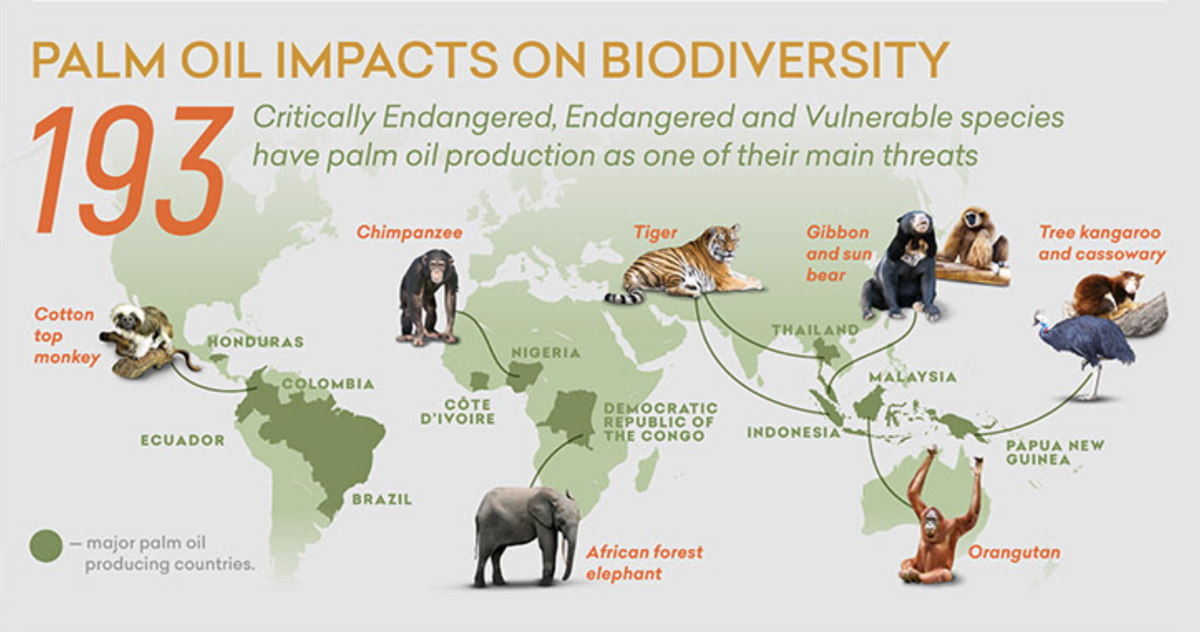
Notes:
https://iucn.org/resources/infographic/palm-oil-and-biodiversity-infographic

Slide 13
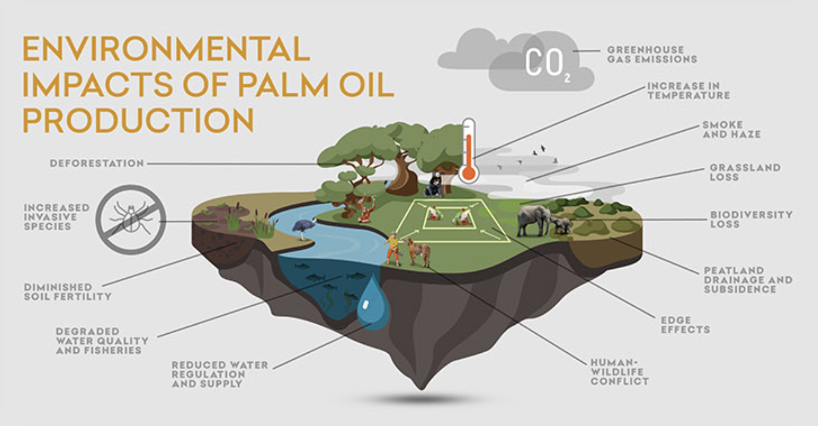
Notes:
https://iucn.org/resources/infographic/palm-oil-and-biodiversity-infographic

Slide 14
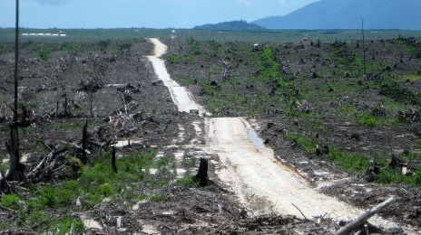
Oil palm conversion = an economic metabolism shift
When forest is converted to oil palm plantation, the entire energy logic changes
What oil palm represents economically
A high-throughput energy system
Designed to:
capture solar energy fast
convert it into a single commodity
export that energy rapidly to global markets
From an entropy perspective, this is a metabolic acceleration

Slide 15

From Indigenous Forest to Oil Palm Plantation
Before
Energy flows: diffuse, multi-directional
Entropy handled internally
(nutrient cycling, regeneration)
Order maintained across:
Ecosystems
Communities
Generations
After
Energy flows: linear and accelerated
Entropy exported as:
deforestation
soil degradation
biodiversity loss
chemical runoff
carbon emissions
Social disorder exported too:
land conflict
weakened customary tenure
dependence on wage labor and global prices

Slide 16
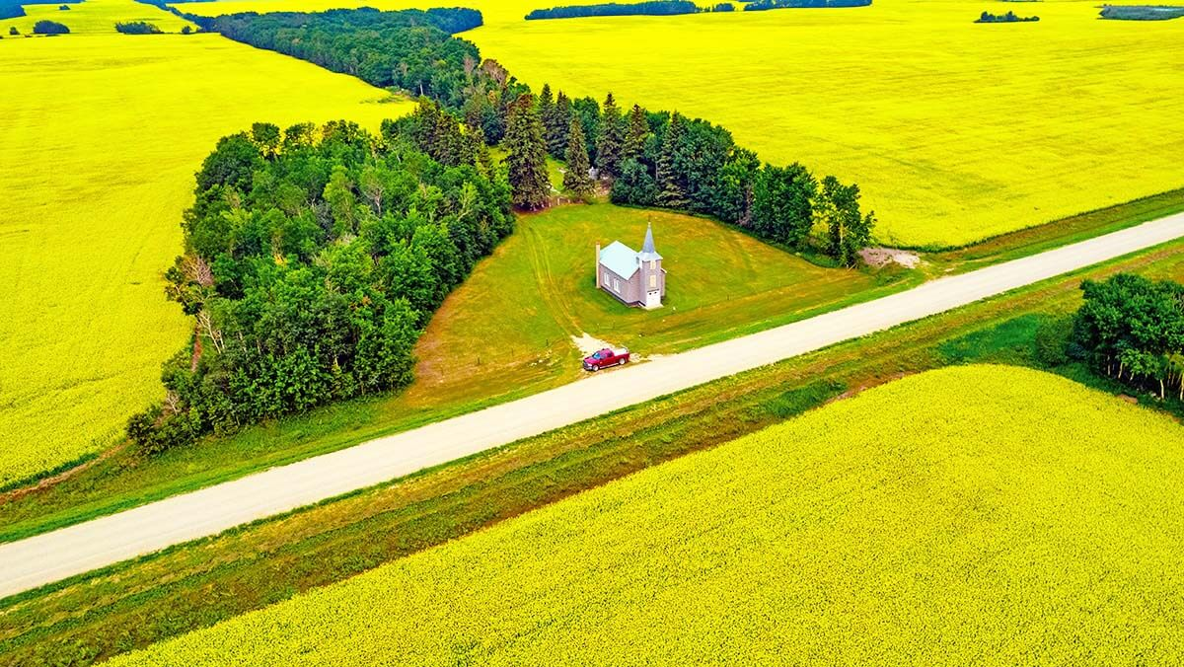
The plantation looks “ordered,” but only because disorder has been displaced elsewhere.

Slide 17
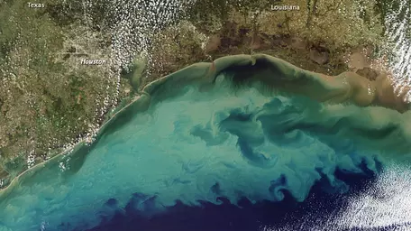
Gulf of Mexico “Dead Zone”

Slide 18
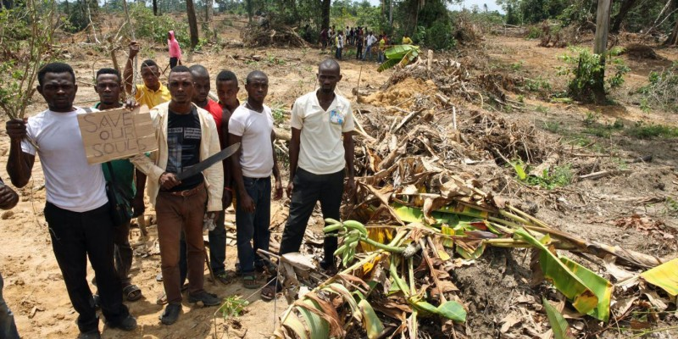
Economies maintain internal order by exporting entropy to ecosystems and communities.
Oil palm plantations:
create economic order (profits, supply chains, GDP growth)
by generating ecological disorder (carbon release, habitat loss)
and social disorder (erosion of Indigenous governance systems)
The “efficiency” of oil palm is not magic—it’s thermodynamic displacement

Slide 19
Environmental crises emerge when entropy export exceeds the capacity of sinks.
In places such as Papua New Guinea:
Forests once absorbed waste, heat, and disturbance
Large-scale conversion overwhelms those sinks
Damage accumulates faster than recovery is possible
So:
Climate change = atmospheric entropy overload
Biodiversity loss = ecological simplification
Land conflict = social entropy
All are symptoms of energy flows moving too fast, too narrowly, and too externally

Slide 20
Indigenous Resource Governance
Customary land systems are not just cultural—they are entropy-regulating institutions
They slow extraction, diversify energy use, embed decision-making in place-based knowledge
When these systems are displaced entropy is no longer managed locally; control over energy flows shifts outward; communities lose the ability to maintain internal order
This is why forest conversion is not just land-use change—it is a loss of thermodynamic sovereignty

Slide 21
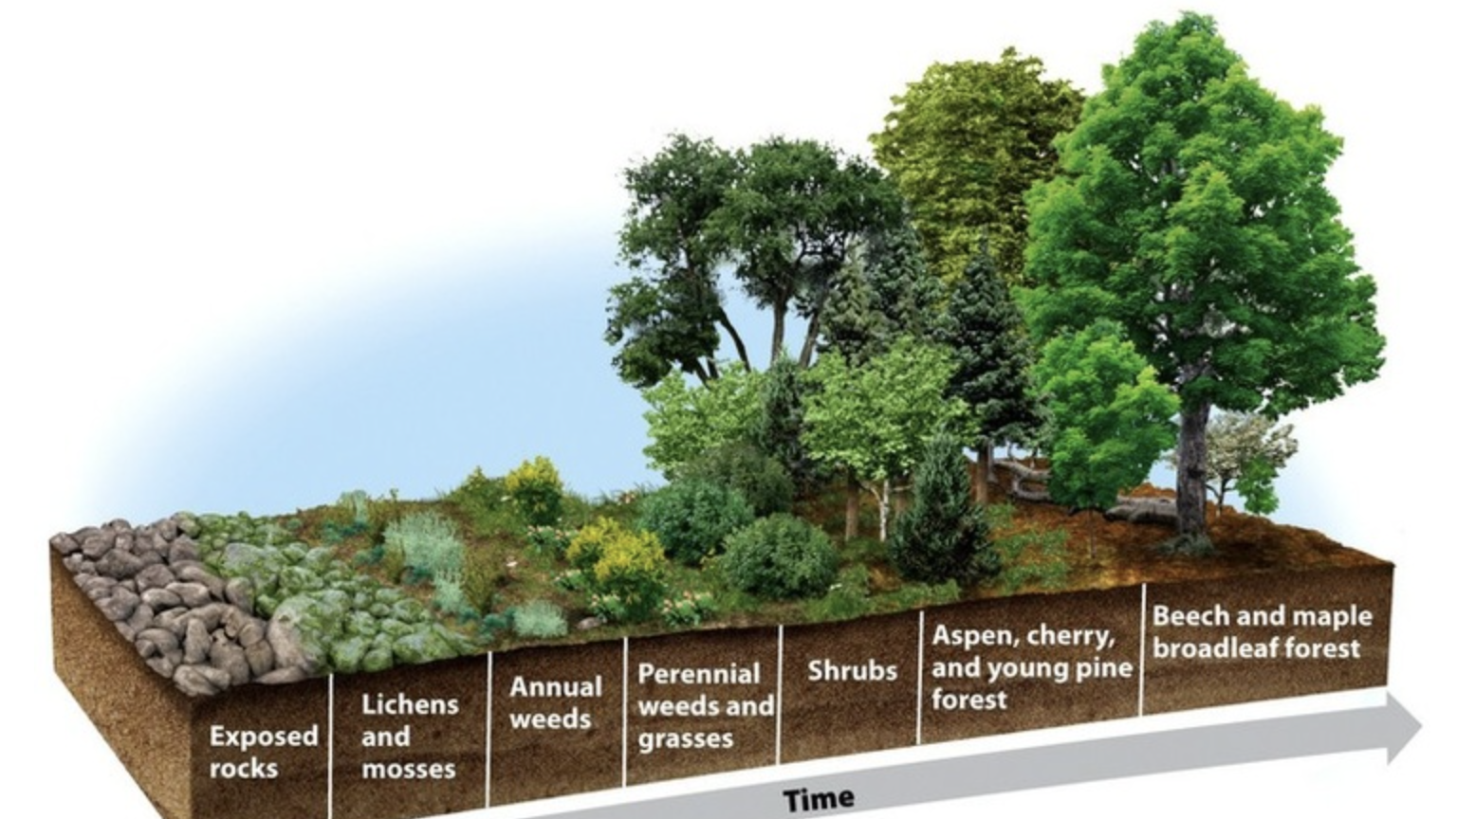
Ecological Succession

Slide 22
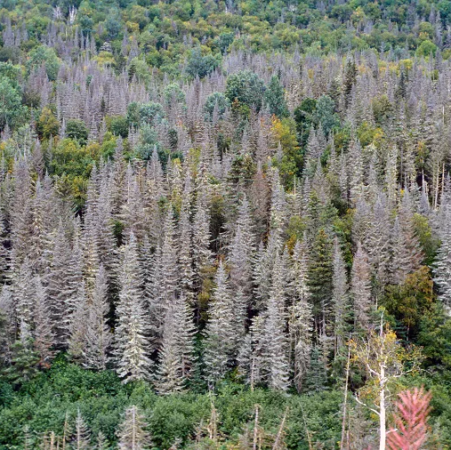
“Climax Community”?
Fire
Flooding
Ice storms
Insect infestations
Notes:
Is there a final successional stage in equilibrium with the environment? Cyclic succession and spruce budworm. But ‘wasp’ intervention??

Slide 23
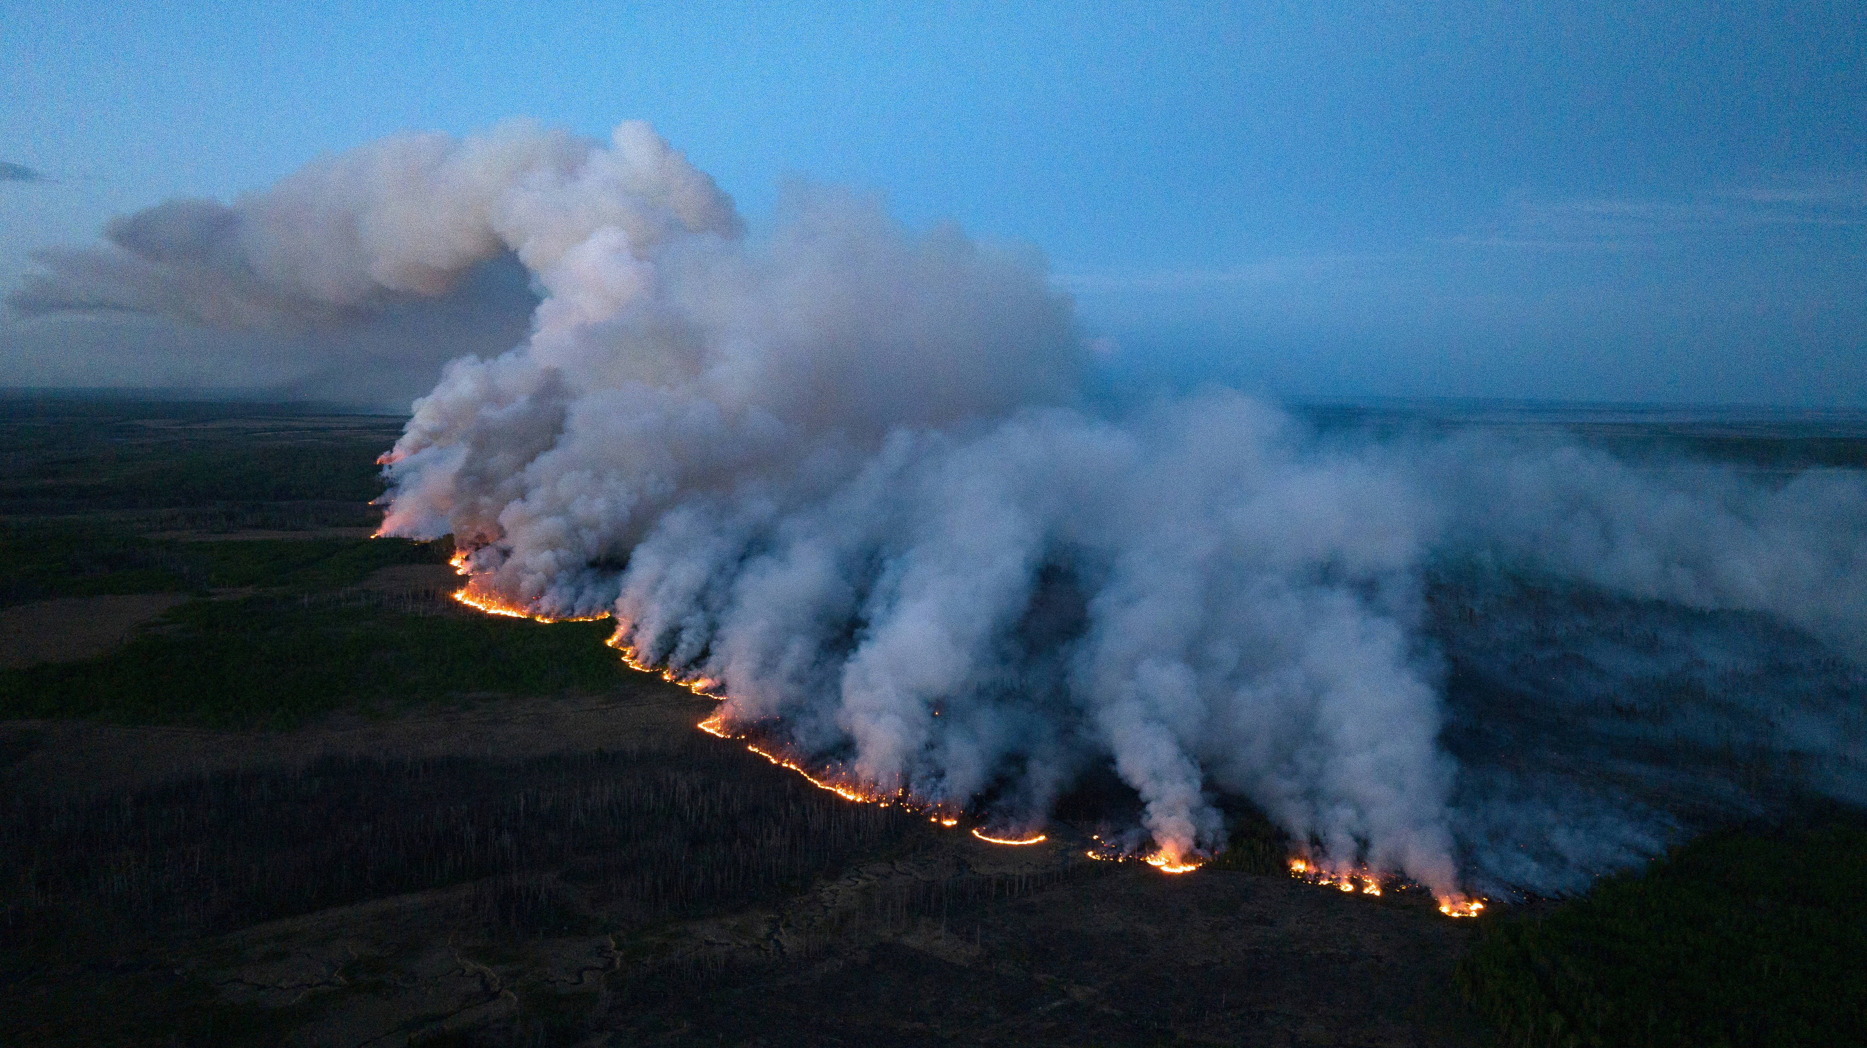
Dynamic Ecosystem
Disturbances are natural
Cataclysmic
Micro-/Meso-/Macro-disturbance
Humans disturbance
Shallow
Thorough-going

Slide 24
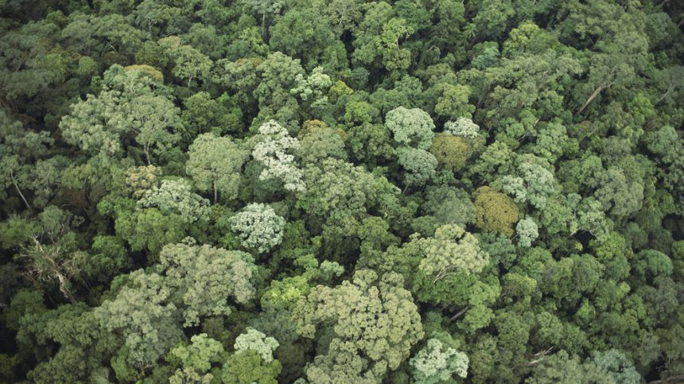
Mature Forest Community
Climax vegetation
Species assemblage more constant over time
On-going changes a function of changes in pathogens, predation, climate
Climax vegetation strongly influenced by prevailing climate and is therefore known as “climatic climax”

Slide 25
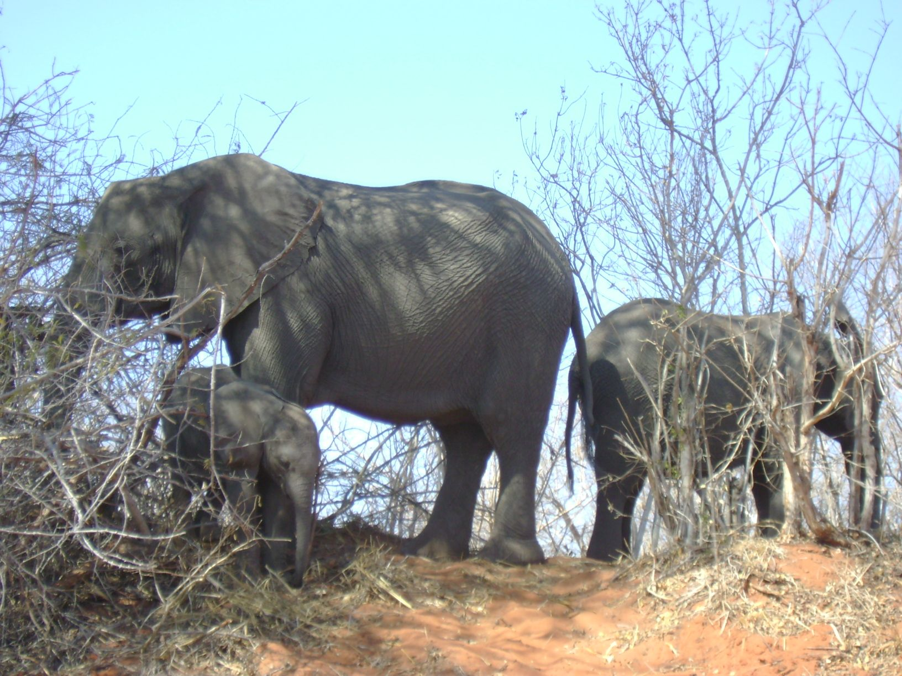
Carrying Capacity of an Ecosystem Population size is a function of reduction/growth factors
Biotic
Abiotic
Predators
Disease
Parasites
lack of food
Reproduction rate
Ability to migrate
Ability to hide/disguise
Light
Temperature
Weather
Water
Chemical environment

Slide 26

Durability of Ecosystems Varies
Inertia (keep going)
Resilience (bounce back)
Temperate Zones with ‘high inertia’ and ‘high resilience’ (e.g. where we have settled and John Keegan calls “lands of first choice”)

Slide 27
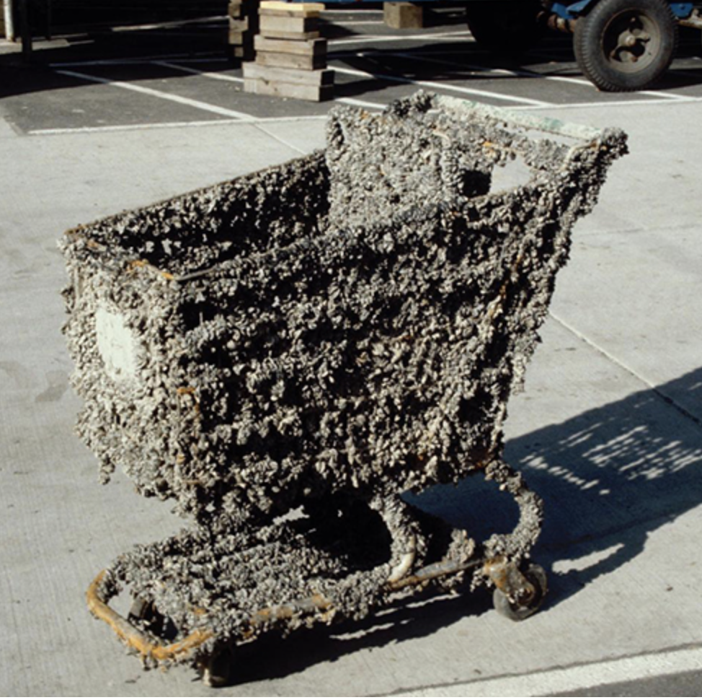
Human Impacts
Direct
Harvest
Land conversion (including species removal)
pollution
Indirect
invasive species (zebra mussel; dutch elm disease)
6.4% of 50,534 species assessed in Wild Species 2020: The General Status of Species in Canada are not native
Notes:
https://cscd-in.org/zebra-mussel-prevention (Cordry-Sweetwater Conservancy far south of Chicago); https://www.canada.ca/en/environment-climate-change/services/species-risk-public-registry/general-status/wild-species-2020.html#toc0

Slide 28
Implications
Ecosystems change over time
Ecological succession occurs as a slow adaptive process involving the gradual replacement of one assemblage of species by another as conditions change over time
Ecosystems tend toward dynamic equilibrium
Feedback mechanisms that may either exacerbate (positive feedback loops) or mitigate (negative feedback loops) change

Slide 29

Key Takeaway
“We cannot impose static management regimes on dynamic ecosystem processes without causing ecological disruption.”
“When faced with such dynamic ecosystem changes, we must use equally dynamic thinking to confront the challenges of the future.”
-- Dearden & Mitchell, 2012, p. 111

